Slide 1
Inquiry
Unit

Slide 2
Inquiry Menu
  Scientific Instruments
    Spring Scale
  Triple Beam Balance
  Barometer
  Sling psychrometer
Scientific Investigation
  Quantitative
  Qualitative
  Inference
Compiling Data
  Data Table
  Independent Variables
  Dependent Variables
Compiling Data (continued)
  Graphs
    Pictograph
    Bar
    Circle
    Line
    Drawing a Line Graph
    Interpreting a Graph
Classifying Objects and Organisms
  Dichotomous Key
Technological Design
Controlled Experiment
Lab Safety
  Symbols
  Scenarios

Slide 3
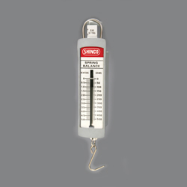
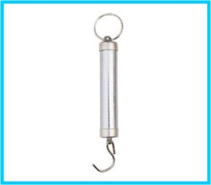
Scientific Instruments:
Spring Scale
A spring scale is used to measure the weight or the force on an object.
Some spring scales have a slider that moves in response to the weight/force of an object.
The measurement is read on one of two scales located on either side of the slider.
Before an object is attached to the spring scale, make sure the marker is on the zero (0) by adjusting the slider or knob usually found on the top of the scale.
A spring scale measures weight or force in newtons (N).

Slide 4
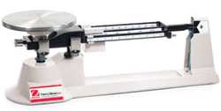
Triple Beam Balance
Virtual Activity

Slide 5
A beam balance (triple) is a tool used to measure the mass of an object.
The beam balance contains a pan or platform, three beams with riders/sliders and a pointer.
How to use a Triple Beam Balance: virtual activity
Step 1: Before measuring, make sure all riders/sliders are set at zero (0), the pointer is in line with its zero (0) mark and the pan is clean.
Step 2: Place an object to be measured on the pan or platform. If the object is placed in a container or on weighing paper, the mass of the container or paper needs to be subtracted from the final mass of the object.
Step 3: Three beams are found on the side opposite of the pan. Each beam is marked in different increments: 100 grams, 10 grams, and tenths (0.1) of a gram up to 10 grams.
After placing the object on the pan, the pointer will rise.
Step 4: To determine the mass of the object, gently slide the riders/sliders across the beams until the pointer lines up exactly with the zero (0) mark on the scale. Be sure the riders/sliders with notches are securely placed in their notches.
Step 5: The mass is calculated by adding the sum of the measures indicated by the riders/sliders.
Step 6: A beam balance measures the mass of an object in grams (g).

Slide 6
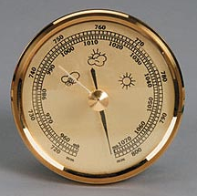
Barometer
A barometer is an instrument used to measure air pressure or a change in pressure readings.
The other pointer that is found on most instruments is the set pointer and is usually made of brass.
The set pointer can be turned by means of the knob at the center of the glass so that it covers the reading pointer. If the reading pointer has moved between readings then it can be determined that the pressure is now lower or higher and by how much.
A barometer scale is measured in
millimeters or inches of mercury or
millibars (mb).

Slide 7
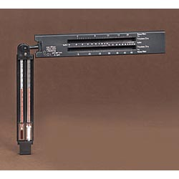
Sling Psychrometer
A sling psychrometer is a tool used to measure relative humidity by using two thermometers—a wet bulb and a dry bulb.
The wet bulb thermometer is covered with a piece of cloth and moistened.
The two thermometers are then moved through the air. After a period of time the temperature of each thermometer is recorded. A relative humidity chart is used to determine the relative humidity percent.

Slide 8
Scientific Investigation
Data should be collected throughout a controlled scientific investigation. Data includes both scientific observations and inferences.
A scientific observation is gained by carefully identifying and describing properties using the five senses or scientific tools and can be classified as quantitative or qualitative.

Slide 9
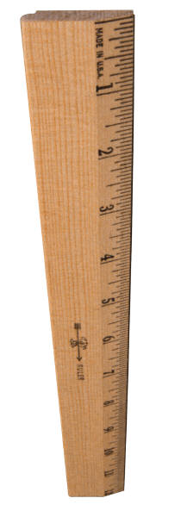
Quantitative observations are observations that use numbers (amounts) or measurements

Slide 10
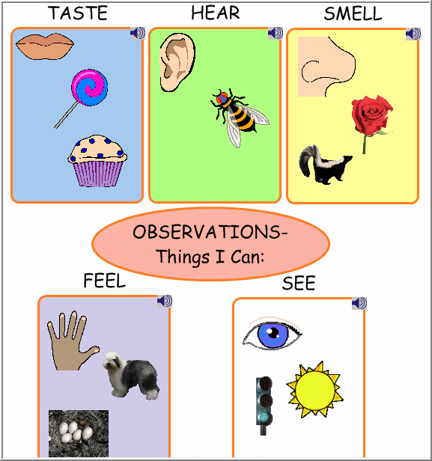
Qualitative observations are observations that are made using only the senses and refer to specific properties
(the “l” stands for look with your 5 senses!)

Slide 11
An inference is an explanation or interpretation of an observation based on prior experiences or supported by observations made in the investigation. They are not final explanations of the observation. There may be several logical inferences for a given observation. There is no way to be sure which inference best explains the observation without further investigation.
Looking at the picture, can you infer why everyday a hummingbird comes to a red flower instead of going to any of the other colors in the garden?
Answer: “I infer that the reason a hummingbird always goes to a red flower is because . . . “

Slide 12
Compiling Data
Data from the investigation should be organized in data tables and represented as diagrams or graphs when appropriate.
A data table is used to organize data collected in an experiment so that it can be read easily.
A data table should be planned before the investigation starts.
Consider the purpose of the table, the kind and number of items to be included in the table, the number of times a measurement will be made, and the units to be used.
Data tables are often organized in columns and rows. The columns should have headings that show the quantity and unit of the data in that column.

Slide 13
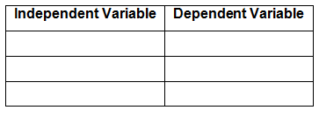
The independent (manipulated) variable is listed in the column on the left side. The dependent (responding) variable is listed in the column(s) on the right side.
If qualitative data is to be gathered, include enough space to write the observations.

Slide 14

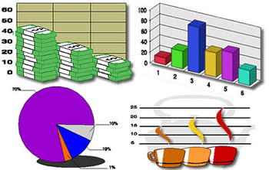
Graphs
Graphs are visuals used to compare data. Graphs show information and relationships between the data.
Different types of graphs show different types of information.

Slide 15
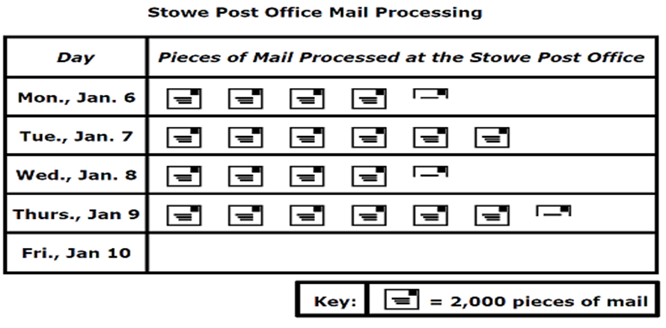
Pictographs
Pictographs use pictures of objects to show quantities.

Slide 16
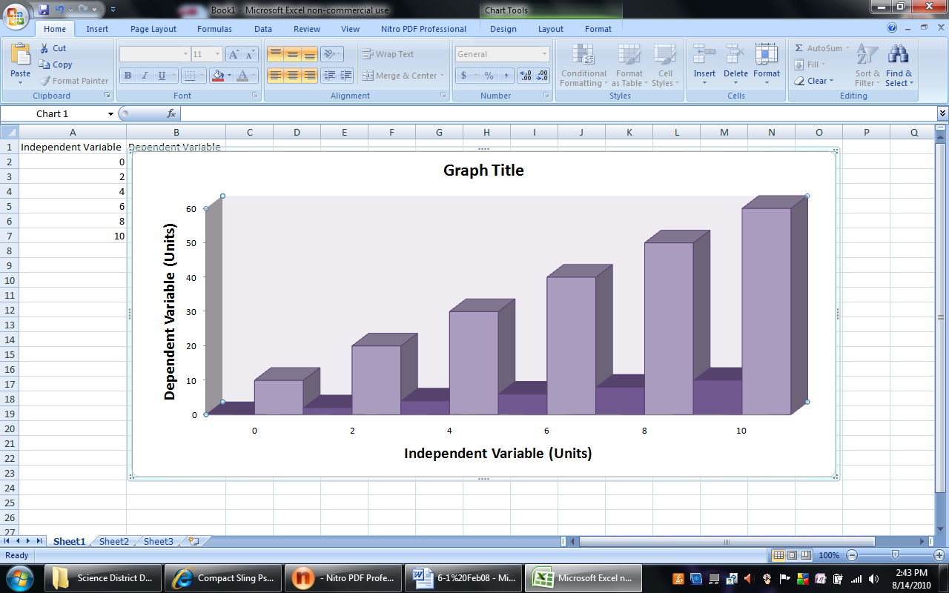
Bar Graphs
Bar graphs are often used for qualitative observations. The lengths of the bars on a bar graph are used to represent and compare data. A numerical scale is used to determine the lengths of the bars.

Slide 17
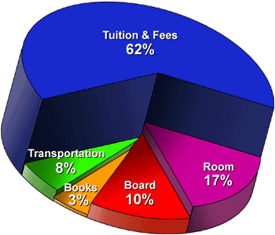
Circle Graphs
Circle graphs show percentages of a whole. The entire circle is equal to 100% of the data.
Steps to make a circle graph.
1. Draw a circle.
2. Find the center point of the circle.
3. Draw a radius.
4. Use a protractor to mark the angle for the first "pie slice."

Slide 18
Line graphs are often used when quantitative data is collected over time. Line graphs show how quantitative data changes over time or relationships between manipulated (changing) variable and responding (resulting) variable. The lines on a line graph show the pattern of changes at a glance.
How to draw a line graph: Draw a horizontal line (x-axis) and a vertical line (y-axis) that meet at a right angle.
Drawing a Line Graph
Yaxis
X-axis

Slide 19
The independent (manipulated) variable is written on the x-axis.
The dependent (responding) variable is written on the y-axis.
dependent / responding
Yaxis
independent (manipulated) variable
X-axis

Slide 20
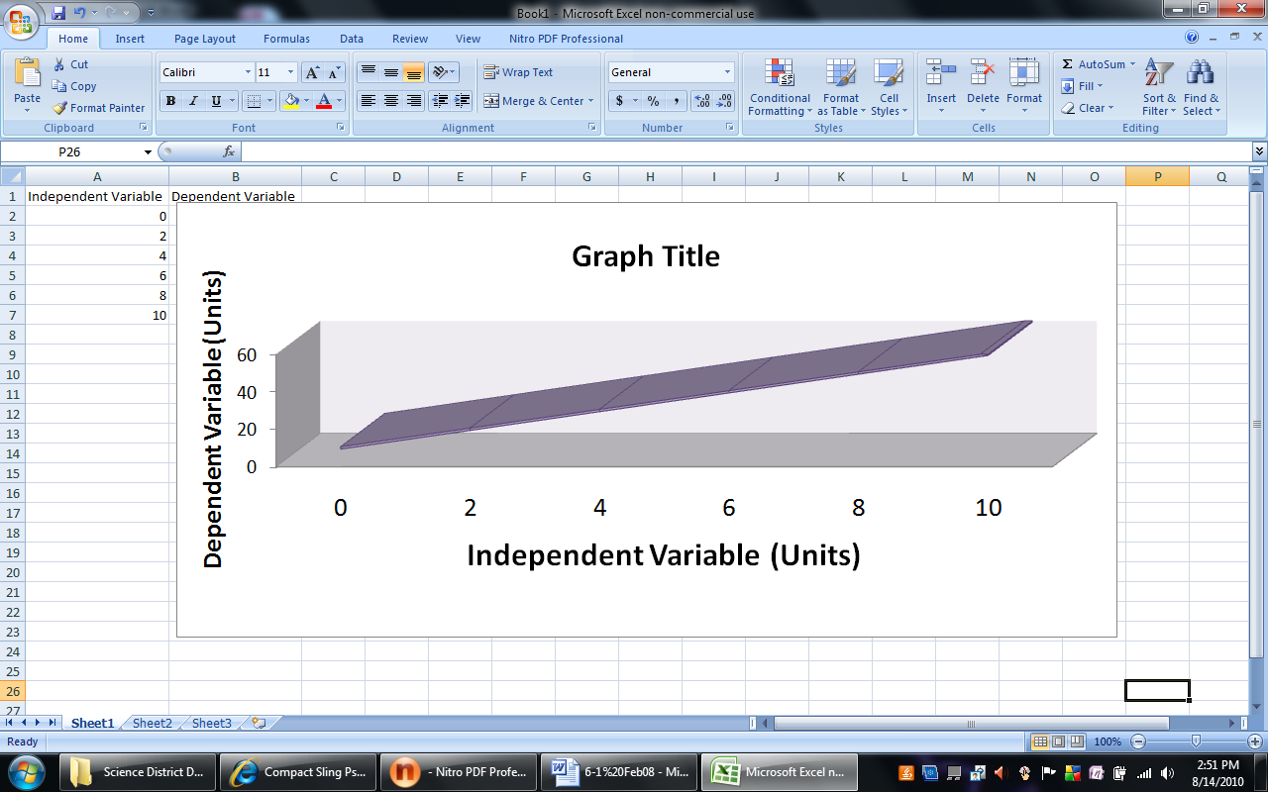
Yaxis
X-axis

Slide 21
Include appropriate units of measurement for each variable.
Look at the range of data (lowest and highest) to determine the intervals or increments (numbers on the axes) of the x-axis and the y-axis.
The increments do not need to be the same for both the x-axis and the y-axis, but should be consistent on either axis.
Yaxis
0
X-axis
Label the point at the right angle as zero (0).

Slide 22
Plot the data on the graph as matched pairs. For example, every independent (manipulated) variable number will have a corresponding dependent (responding) variable number. Connect the points on the line graph.
Write an appropriate title for the graph that contains the names of both variables.
120
100
Yaxis
80
60
40
20
0
1
2
3
4
5
6
7
8
9
10
11
X-axis
Label the point at the right angle as zero (0).

Slide 23
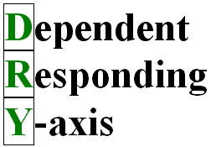
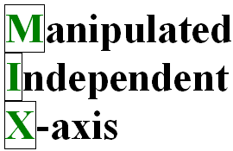
“DRY MIX” can help you remember which variable belongs on the axis.
DRY represents Dependent-Responding-Y-axis.
MIX represents Manipulated-Independent-X-axis.
Title of Graph: Temperatures in New York City
120
100
Yaxis
80
60
40
20
0
1
2
3
4
5
6
7
8
9
10
11
X-axis
Label the point at the right angle as zero (0).

Slide 24
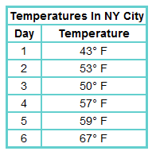
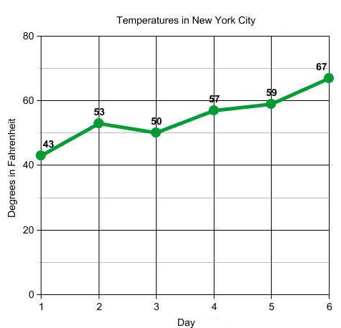
Interpreting a Graph
Yaxis
The data table above and line graph to the right shows temperatures in New York City in degrees Fahrenheit.
X-axis

Slide 25
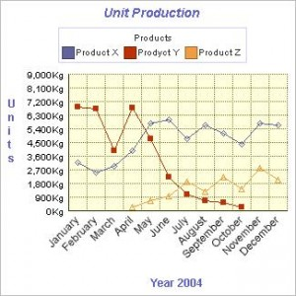
Sometimes calculations or graphs will be needed to help analyze the data. Data will often reveal patterns or trends.
The analyzed data can then be used to draw a valid conclusion
about the investigation.

Slide 26
A valid conclusion is a summary of the findings of an experiment based on scientific observations, inferences, and collected data that states the relationship between the independent (manipulated) and dependent (responding) variables.
When a conclusion statement is made it should state whether the collected data supports the hypothesis or does not support the hypothesis (not that the hypothesis was right or wrong).

Slide 27
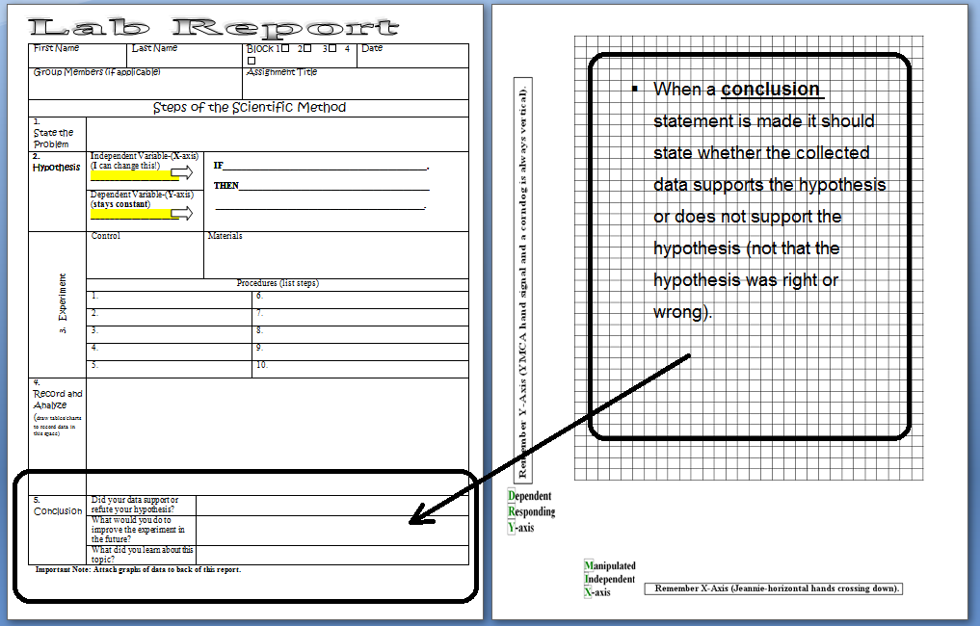

Slide 28
Classifying Objects and Organisms
Objects can be classified based on similar characteristics using a binary classification chart (based on whether or not an object has or does not have a particular property) or an identification key.
Kingdom-King
Phylum-Phillip
Class-Came
Order-Over
Family-For
Genus-Great
Species-Spaghetti

Slide 29
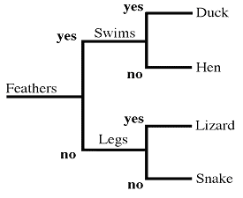
A dichotomous key is a special identification key that uses a series of paired characteristics that leads to the identification of an organism, object, or material.
Always begin with a choice from the first pair of characteristics.
At the end of each characteristic is either the name of the organism, object, or material or directions to go to another step.
Keep following the choices until the identity is determined.
Once the identity is determined, the physical characteristics can be identified.
Warm Up Copy all 3-7-13
1. Copy all notes , show teacher.
2. Read and do questions on worksheet , show teacher.
3. Read pages 23-30 in hard book.
Example of a
Dichotomous Key

Slide 30
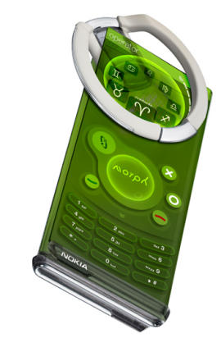
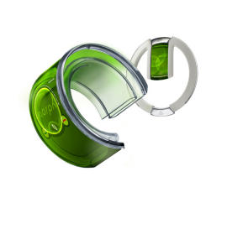
Technological Design
Science is the process of learning about the natural world by asking questions and trying to find the answers to those questions. Scientific knowledge is used to develop and enhance science knowledge. Technology applies scientific knowledge in order to develop a solution to a problem or create a product to help meet human needs. Technology is usually developed because there is a need or a problem that needs to be solved.

Slide 31
Steps in the technological design process include:
Step 1: Identifying a problem or need
Research and gather information on what is already known about the problem or need
Step 2: Designing a solution or a product
Generate ideas on possible solutions or products
Evaluate the factors that will limit or restrict the solution or product design
Determine the trade-offs of the solutions or products (what must be given up in order to create the solution or product)
Step 3: Implementing the design
Build and test the solution or product
Identify any problems with the solution or product
If necessary, redesign the solution or product to eliminate any problems in the design
Step 4: Evaluating the solution or the product
Determine if the solution or product solved the problem
Identify the pros and cons of the solution or product
The steps of the design can be communicated using descriptions, models, and drawings.
A scientific model is an idea that allows us to create explanations of how the
something may work. Models can be physical or mental.

Slide 32
Controlled Experiment
In a controlled scientific investigation some or all of the following steps should be included:
1. Identify a testable question (tests one variable) that can be investigated.
2. Research information about the topic.
3. State the hypothesis as a predicted answer to the question, what may be the possible outcome of the investigation.
4. Design an experiment to test the hypothesis, controlling all variables except the independent (manipulated) variable.
5. Plan for independent (manipulated) and dependent (responding) variables.
6. Plan for factors that should be held constant (controlled variables).
7. List the materials needed to conduct the experiment.
8. List the procedures to be followed.
9. Plan for recording, organizing and analyzing data.
10. Conduct the experiment and record data (observations) in tables, graphs, or charts.
11. Analyze the data in the tables, graphs, or charts to figure out what the data means (describe the relationship between the variables).
Compare the results to the hypothesis and write a conclusion that will support
or not support the hypothesis based on the recorded data.
13. Communicate the results to others.

Slide 33
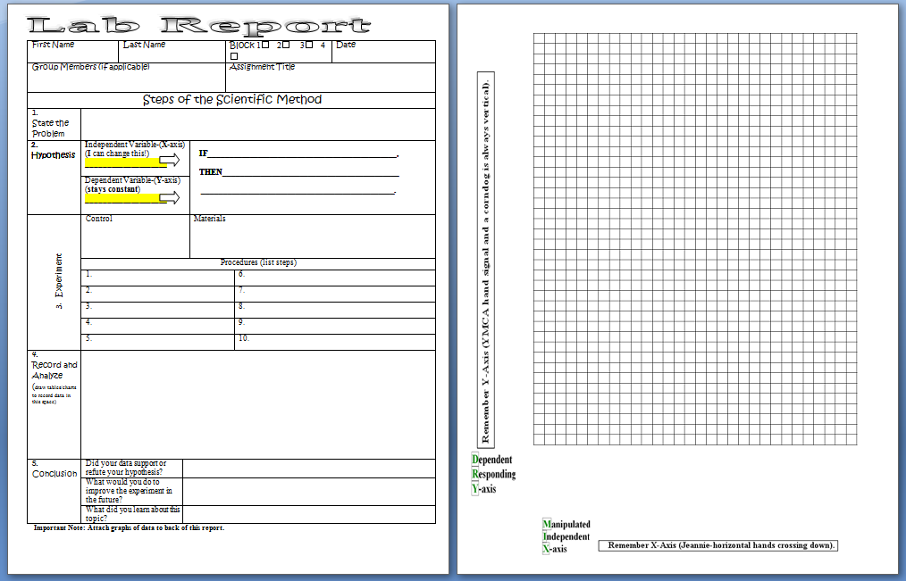

Slide 34

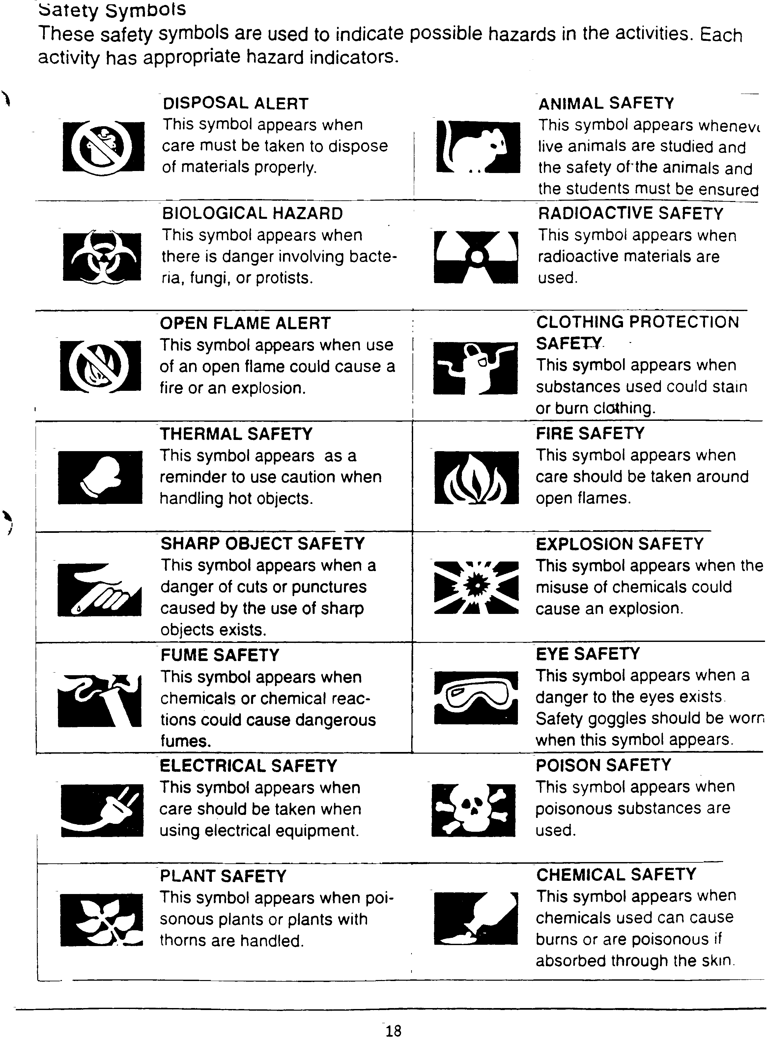
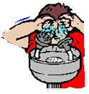
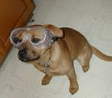
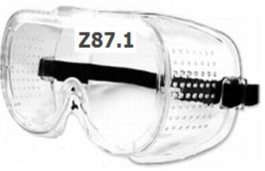
Lab Safety
Care should be taken when conducting a controlled scientific investigation to make sure that everyone stays safe.
Safety procedures to use when conducting science investigations must be:
Always wear appropriate safety equipment such as goggles or an apron when conducting an investigation.
Eye Protection

Slide 35
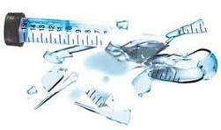


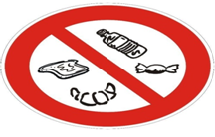
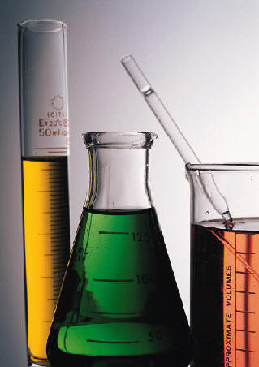
Sharp Objects
Be careful with sharp objects and glass. Only the teacher should clean up broken glass.
Do not put anything in mouth or smell unless instructed by the teacher.
Chemical Safety

Slide 36
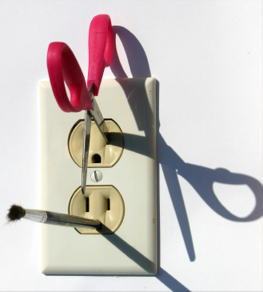

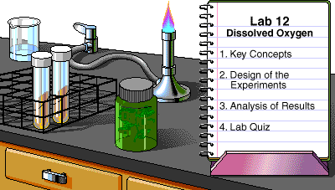
Electrical Safety
Do not put anything in mouth unless instructed by the teacher.
Follow all directions for
completing the science
investigation.
Follow Directions!

Slide 37
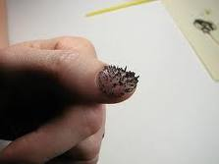
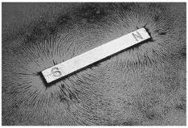

Plants & Animals
Follow proper handling of animals and plants in the classroom.
Keep hands away from eyes when using iron filings.
Keep the workplace neat. Clean up when done.
Iron Filings
Clean Up

Slide 38
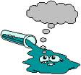
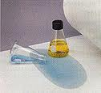
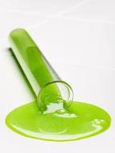
Practice Safety Procedures
Be
Practice all of the safety procedures associated with the activities or investigations conducted.
Tell the teacher about accidents or spills right away.
Wear an apron when working with chemicals.
Wear an gloves when working with chemicals.
Hand Safety
Spills
Apron
Gloves

Slide 39
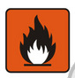

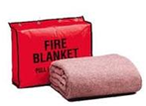
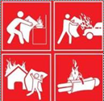


Heat
Fire Blanket – Located in back of classroom in the red container
Fire Extinguisher –
Located in science room closet by door.
To operate the fire extinguisher remember
P-A-S-S
P- Pull the Pin
A-Aim the hose at the base of the fire from 5-6 feet away.
S-Squeeze the handle.
S-Sweep the hose back and forth across the fire.
On Fire?
REMEMBER: Stop, Drop, & Roll

Slide 40
What’s Wrong With This Picture?
Lab Safety Scenario #1

Slide 41
What’s Wrong With This Picture?
Lab Safety Scenario #2

